Slide 1



Module 2:
Enhancing Quality of Life Outcomes through Inclusive and Person-Centred Approaches

Slide 2

Module 2 Overview
Provide a link between Module 1 and the approaches and strategies presented in later modules
Provide important foundational knowledge about inclusive and person-centred approaches and the way in which disability can intersect with other individual characteristics
Introduce you to the QOLIVET Good Practice Guidelines on Enhancing the Quality-of-Life impact of Services

Slide 3


Module 2: Learning Objective 1
On successful completion of this module, you will be able to:
Understand disability from a biopsychosocial perspective
Identify learning needs and strengths
Understand the importance of Person centred planning & support planning
Reflect upon how these are demonstrated in supports, intervention and adaptations

Slide 4
Module 2: Learning Objective 2
On successful completion of this module, you will be able to:
Describe the importance of Universal Design for Learning (UDL) for creating accessible environments and experiences
Describe the benefits of assistive technology
Understand how technology can contribute to more inclusive environments

Slide 5
Guidelines on Enhancing
the Quality-of-Life impact of Services
The QOLIVET Good Practice Guidelines on Enhancing the Quality-of-Life impact of Services

Slide 6
Generating the Good Practice Guidelines
A number of activities were involved in producing the QOLIVET Guidelines
A systematic search of literature and other sources
Consultation with staff and stakeholders in the participating jurisdictions including disability representative organisations
A review by a content expert

Slide 7




The Scope and Context of the Guidelines

Slide 8
The Scope and Context of the Guidelines
The Guidelines are based on the Schalock / Verdugo model of QoL which consists of three domains:
Personal Development
Wellbeing
Social Inclusion
There is a strong correspondence between the model and the UN Convention on the Rights of Persons with Disabilities (CRPD)

Slide 9

Underpinning Concepts of the QOLIVET Approach
QoL impact is a priority outcome for all services that span the pathway to inclusion
Community Care
Pre-Vocational Training
Specialised Training
Mainstream Training
Vocational Rehabilitation

Slide 10



Underpinning Concepts of the QOLIVET Approach

Slide 11
Creating Pathways to inclusion

Slide 12




The Status of QOL in Community Care

Slide 13





The Status of QOL in VET

Slide 14
Prerequisites for an Effective Pathway 1
Regardless of the service in which a person is participating, it is essential that:

Slide 15
Prerequisites for an Effective Pathway 2
Regardless of the service in which a person is participating, it is essential that:

Slide 16
The Good Practice Guidelines on Enhancing the QoL impact of Services
The 15 good practice guidelines are intended to intended to inform the other capacity building mechanisms being developed by the QOLIVET project
Relevance to the community care and VET sectors by applying the Schalock/Verduigo model of QoL
They reflect the foundational principles upon which a sustainable pathway to inclusion can be built

Slide 17
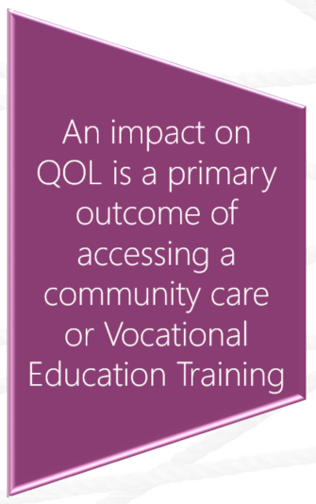

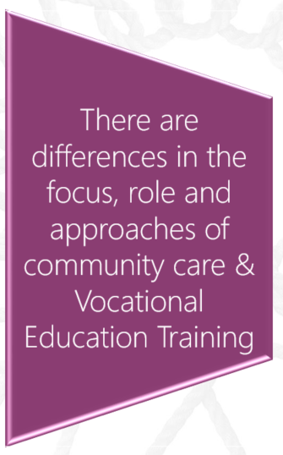
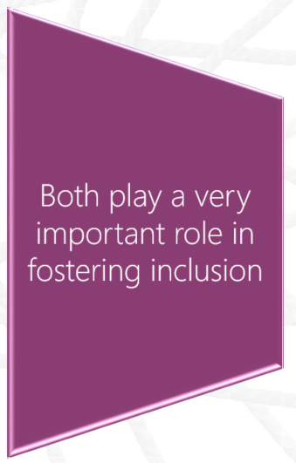
Good Practice Guideline 1
QoL is a fundamental impact of both community care (CC) and Vocational & Educational Training (VET)

Slide 18
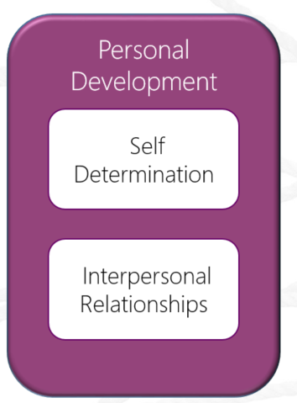
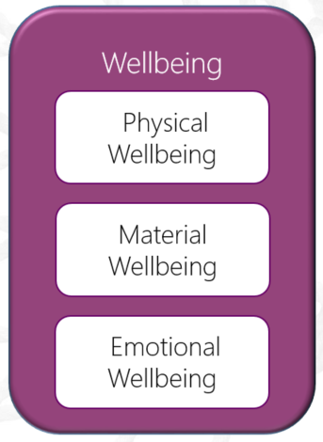
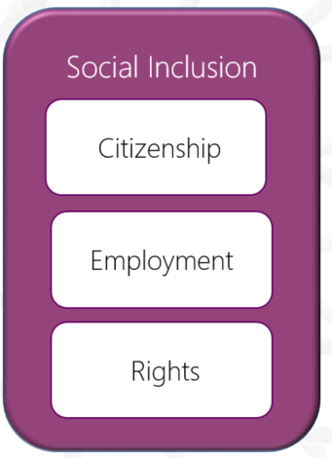
Good Practice Guideline 2
QoL is multidimensional and influenced by personal and environmental factors:

Slide 19


Good Practice Guideline 3
QoL has the same components for all people
Family
Health
Friends
Good Life?
Education
Home
Work

Slide 20

Activity: Worksheet 1 - Reflection
Take some time now and reflect on what makes a good life for you:
What does a quality life mean for you?
Write down 3 to 5 things that indicate you have a good quality of life

Slide 21

Activity: Worksheet 2 – QoL Indicators
These statements represent indicators of a QoL, please pause and complete worksheet 2
I can manage my financial situation
I have confidence
I can do physical activities
I can manage my health & wellbeing
I can make my own decisions
I can earn a living
I understand and exercise my rights in society
I have Friends
I can enjoy my leisure time

Slide 22
Good Practice Guideline 4
The QoL principles must underpin interventions and outcomes for persons with disabilities
Continuous Improvement Processes
Continuous Improvement
Plan
Do
Check
Act
Individualised assessment identifying support needs for and barriers to QOL
Person Centred Planning

Slide 23
Activity: Worksheet 3 – Continuous Improvement
Please pause and complete worksheet 3
Continuous Improvement
Plan
Do
Check
Act
Plan: Support the generation of individual goals and program aims
Do: utilise a person centred planning process
Act: Adjust program content and supports to best achieve individual goals
Check: monitor program content against individual aims and goals

Slide 24
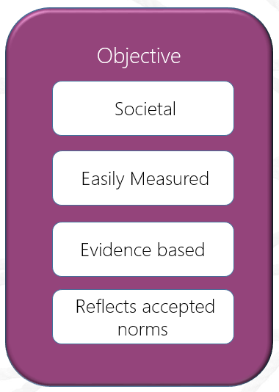
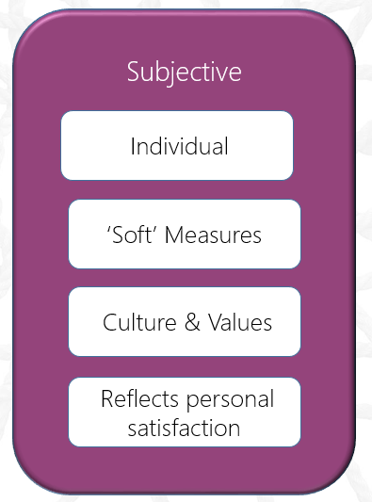
Good Practice Guideline 5
QoL needs to be measured using both subjective and objective indicators

Slide 25
Good Practice Guideline 6
Enhanced QoL impact is an essential key performance indicator for services
Subjective
Data
Measure
&
Review
Report
Amend
Repeat
KPI
Key Performance Indicator
Objective
Data

Slide 26
Good Practice Guideline 7
Enhanced QoL implies respect, dignity, equality, inclusion, participation and rights
Respect
Equality
Rights
Participation
Dignity
Inclusion

Slide 27
Good Practice Guideline 8
Staff need to be equipped with the competencies that impact on the QoL of participants through development of mandatory training
Attitudes
Skills
Training
Commitment
Attributions
Inclusion

Slide 28






Good Practice Guideline 9
Meaningful participant involvement in service development leads to better QoL impact

Slide 29
Activity: Worksheet 4 – Meaningful Involvement
Take some time now and consider how you support meaningful participant involvement in your service development:
See worksheet 4, for examples.
Give one example for each

Slide 30
Good Practice Guideline 10
Participants need to be actively involved in setting QoL goals and evaluating outcomes
Values
Goals
Evaluation
Person Centred Planning

Slide 31
Good Practice Guideline 11
Collaboration with communities and other agencies enhances QoL impact
Health Services
Labour Market
Community Organisations
Recreational Groups
Social Services

Slide 32
Good Practice Guideline 12
Community Care
Vocational Education Training
Synergies between community care and VET are central to improving QoL impact
Personal Growth
Effective Learning Skills
Social Participation
Accessible Learning Environments
Environmental Supports

Slide 33
Good Practice Guideline 13
Community-wide awareness of QoL principles need to be promoted
Reduce Negative Attitudes
Support Valued Work & Community Roles
Dismantle Stereotypes
Foster Community Experience

Slide 34
Good Practice Guideline 14
Policies
Processes
Training
QoL impact must be supported by system policies, processes and training
Employment
Education
Social Protection
Goods & Services

Slide 35
Good Practice Guideline 15
QoL outcomes can be enhanced through inclusive and person-centred strategies
Person-centred delivery and organisational ethos
Inclusive strategies and settings
A holistic and biopsychosocial approach
Universally designed environments and processes
Creating opportunities to develop self-determination and decision making
Access to appropriate assistive technologies
Fostering personal and interpersonal competences
Matching supports and interventions to identified needs
Encouraging empathetic and positive communication
Healthy balance between QoL outcomes ‘Important To’ and ‘Important For’ the person
Building resilience in the face of challenges

Slide 36
Good Practice Guideline 15
QoL outcomes can be enhanced through inclusive and person-centred strategies
Person-centred delivery and organisational ethos
Inclusive strategies and settings
A holistic and biopsychosocial approach
Universally designed environments and processes
Person-centred delivery and organisational ethos
Creating opportunities to develop self-determination and decision making
Access to appropriate assistive technologies
Fostering personal and interpersonal competences
Matching supports and interventions to identified needs
Encouraging empathetic and positive communication
Healthy balance between QoL outcomes ‘Important To’ and ‘Important For’ the person
Building resilience in the face of challenges

Slide 37
Good Practice Guideline 15
QoL outcomes can be enhanced through inclusive and person-centred strategies
Person-centred delivery and organisational ethos
Inclusive strategies and settings
A holistic and biopsychosocial approach
Universally designed environments and processes
A holistic and biopsychosocial approach
Creating opportunities to develop self-determination and decision making
Access to appropriate assistive technologies
Fostering personal and interpersonal competences
Matching supports and interventions to identified needs
Encouraging empathetic and positive communication
Healthy balance between QoL outcomes ‘Important To’ and ‘Important For’ the person
Building resilience in the face of challenges

Slide 38
Good Practice Guideline 15
QoL outcomes can be enhanced through inclusive and person-centred strategies
Person-centred delivery and organisational ethos
Inclusive strategies and settings
A holistic and biopsychosocial approach
Universally designed environments and processes
Creating opportunities to develop self-determination and decision making
Creating opportunities to develop self-determination and decision making
Access to appropriate assistive technologies
Fostering personal and interpersonal competences
Matching supports and interventions to identified needs
Encouraging empathetic and positive communication
Healthy balance between QoL outcomes ‘Important To’ and ‘Important For’ the person
Building resilience in the face of challenges

Slide 39
Good Practice Guideline 15
QoL outcomes can be enhanced through inclusive and person-centred strategies
Person-centred delivery and organisational ethos
Inclusive strategies and settings
A holistic and biopsychosocial approach
Universally designed environments and processes
Fostering personal and interpersonal competences
Creating opportunities to develop self-determination and decision making
Access to appropriate assistive technologies
Fostering personal and interpersonal competences
Matching supports and interventions to identified needs
Encouraging empathetic and positive communication
Healthy balance between QoL outcomes ‘Important To’ and ‘Important For’ the person
Building resilience in the face of challenges

Slide 40
Good Practice Guideline 15
QoL outcomes can be enhanced through inclusive and person-centred strategies
Person-centred delivery and organisational ethos
Inclusive strategies and settings
A holistic and biopsychosocial approach
Universally designed environments and processes
Encouraging empathetic and positive communication
Creating opportunities to develop self-determination and decision making
Access to appropriate assistive technologies
Fostering personal and interpersonal competences
Matching supports and interventions to identified needs
Encouraging empathetic and positive communication
Healthy balance between QoL outcomes ‘Important To’ and ‘Important For’ the person
Building resilience in the face of challenges

Slide 41
Good Practice Guideline 15
QoL outcomes can be enhanced through inclusive and person-centred strategies
Person-centred delivery and organisational ethos
Inclusive strategies and settings
A holistic and biopsychosocial approach
Universally designed environments and processes
Building resilience in the face of challenges
Creating opportunities to develop self-determination and decision making
Access to appropriate assistive technologies
Fostering personal and interpersonal competences
Matching supports and interventions to identified needs
Encouraging empathetic and positive communication
Healthy balance between QoL outcomes ‘Important To’ and ‘Important For’ the person
Building resilience in the face of challenges

Slide 42
Good Practice Guideline 15
QoL outcomes can be enhanced through inclusive and person-centred strategies
Person-centred delivery and organisational ethos
Inclusive strategies and settings
A holistic and biopsychosocial approach
Universally designed environments and processes
Inclusive strategies and settings
Creating opportunities to develop self-determination and decision making
Access to appropriate assistive technologies
Fostering personal and interpersonal competences
Matching supports and interventions to identified needs
Encouraging empathetic and positive communication
Healthy balance between QoL outcomes ‘Important To’ and ‘Important For’ the person
Building resilience in the face of challenges

Slide 43
Good Practice Guideline 15
QoL outcomes can be enhanced through inclusive and person-centred strategies
Person-centred delivery and organisational ethos
Inclusive strategies and settings
A holistic and biopsychosocial approach
Universally designed environments and processes
Universally designed environments and processes
Creating opportunities to develop self-determination and decision making
Access to appropriate assistive technologies
Fostering personal and interpersonal competences
Matching supports and interventions to identified needs
Encouraging empathetic and positive communication
Healthy balance between QoL outcomes ‘Important To’ and ‘Important For’ the person
Building resilience in the face of challenges

Slide 44
Good Practice Guideline 15
QoL outcomes can be enhanced through inclusive and person-centred strategies
Person-centred delivery and organisational ethos
Inclusive strategies and settings
A holistic and biopsychosocial approach
Universally designed environments and processes
Access to appropriate assistive technologies
Creating opportunities to develop self-determination and decision making
Access to appropriate assistive technologies
Fostering personal and interpersonal competences
Matching supports and interventions to identified needs
Encouraging empathetic and positive communication
Healthy balance between QoL outcomes ‘Important To’ and ‘Important For’ the person
Building resilience in the face of challenges

Slide 45
Good Practice Guideline 15
QoL outcomes can be enhanced through inclusive and person-centred strategies
Person-centred delivery and organisational ethos
Inclusive strategies and settings
A holistic and biopsychosocial approach
Universally designed environments and processes
Matching supports and interventions to identified needs
Creating opportunities to develop self-determination and decision making
Access to appropriate assistive technologies
Fostering personal and interpersonal competences
Matching supports and interventions to identified needs
Encouraging empathetic and positive communication
Healthy balance between QoL outcomes ‘Important To’ and ‘Important For’ the person
Building resilience in the face of challenges

Slide 46
Good Practice Guideline 15
QoL outcomes can be enhanced through inclusive and person-centred strategies
Person-centred delivery and organisational ethos
Inclusive strategies and settings
A holistic and biopsychosocial approach
Universally designed environments and processes
Healthy balance between QoL outcomes ‘Important To’ and ‘Important For’ the person
Creating opportunities to develop self-determination and decision making
Access to appropriate assistive technologies
Fostering personal and interpersonal competences
Matching supports and interventions to identified needs
Encouraging empathetic and positive communication
Healthy balance between QoL outcomes ‘Important To’ and ‘Important For’ the person
Building resilience in the face of challenges

Slide 47
Good Practice Guideline 15
QoL outcomes can be enhanced through inclusive and person-centred strategies
Person-centred delivery and organisational ethos
Inclusive strategies and settings
A holistic and biopsychosocial approach
Universally designed environments and processes
Creating opportunities to develop self-determination and decision making
Access to appropriate assistive technologies
Fostering personal and interpersonal competences
Matching supports and interventions to identified needs
Encouraging empathetic and positive communication
Healthy balance between QoL outcomes ‘Important To’ and ‘Important For’ the person
Building resilience in the face of challenges

Slide 48
End of Module 2

